Slide 1
Renaissance Humanism
Dr. Stephanie Spoto
5/2/2019
Monterey Peninsula College
Gentrain 407: The Early Renaissance

Slide 2
What is a Humanist? What is Humanism?
?

Slide 4
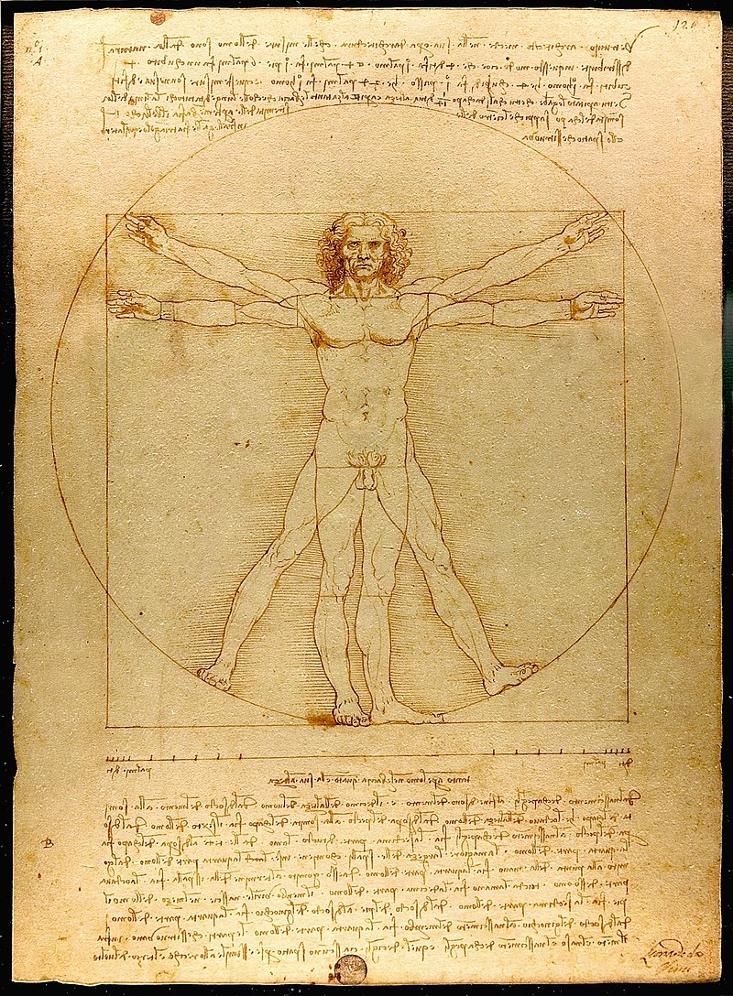
Renaissance Humanism
Study of classical antiquity
A shift in focus from exclusive study of religion towards the study of humankind
Leonardo da Vinci's Vitruvian Man (c. 1490) → proportions of ideal human body with geometry of the ancient Roman architect Vitruvius in his De Architectura.
Vitruvius described the human figure as being like the principal source of proportion among the Classical orders of architecture.

Slide 5
Renaissance Humanism
Began first in Italy, then spread across Western Europe in 14th-16th centuries
“Humanism” a term that is contemporary with that period → however, “Renaissance Humanism” was created later to distinguish it from later Humanist developments.
A reaction against what was considered to be the utilitarian approach of medieval scholasticism. → described by Craig W. Kallendorf as “narrow pedantry”
Goal was to create citizenry that was able to communicate through writing and speech with clarity and eloquence → better engagement with civil life → persuading others to act virtuously
This was to be accomplished through the study of the studia humanitatis, today known as the “humanities”: grammar, rhetoric, history, poetry, and moral philosophy.

Slide 6
Philosophy of secularism
Returning interest in the pagan classics stimulated three major shifts in European philosophy:
the philosophy of secularism
the appreciation of worldly pleasures
Assertion of personal independence and individual expression
Crossroads between medieval supernaturalism and modern skeptical and scientific paradigms

Slide 7
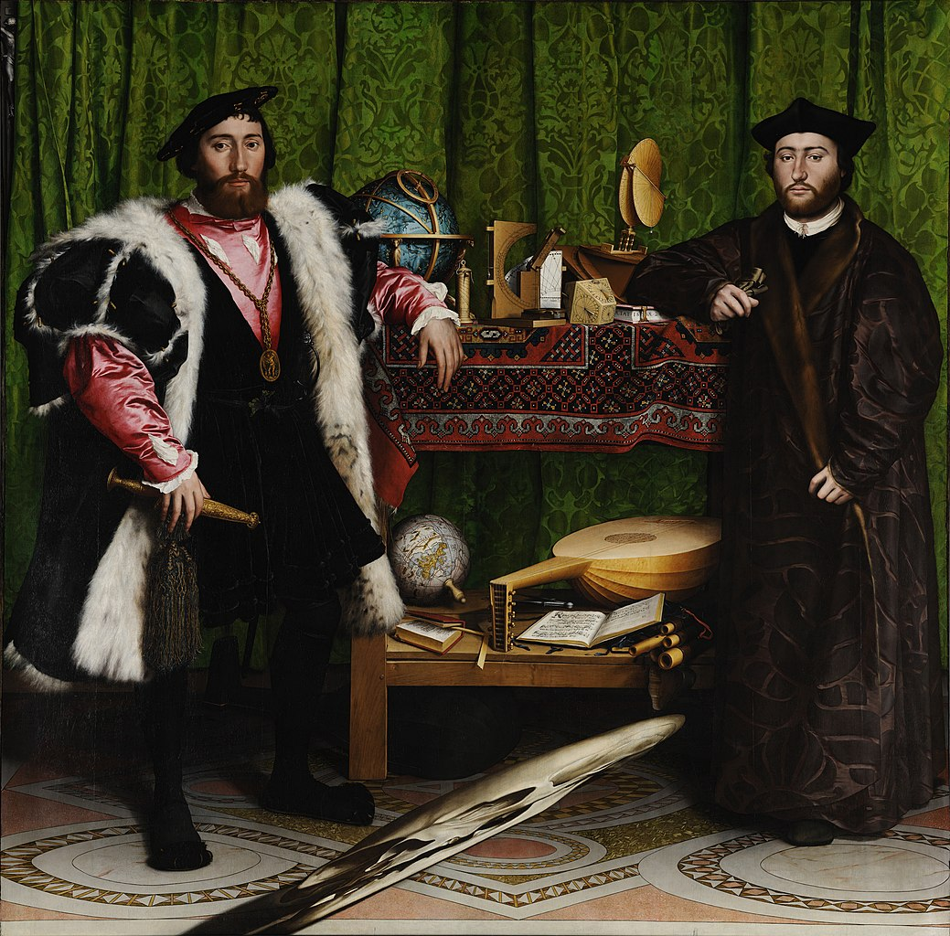
The Ambassadors (1533)
Hans Holbein the Younger
The conflicts between secular and religious authorities are here represented by Jean de Dinteville, a landowner, and Georges de Selve, the Bishop of Lavaur.

Slide 8
“Early Italian humanism, which in many respects continued the grammatical and rhetorical traditions of the Middle Ages, not merely provided the old Trivium with a new and more ambitious name (Studia humanitatis), but also increased its actual scope, content and significance in the curriculum of the schools and universities and in its own extensive literary production. The studia humanitatis excluded logic, but they added to the traditional grammar and rhetoric not only history, Greek, and moral philosophy, but also made poetry, once a sequel of grammar and rhetoric, the most important member of the whole group.”
Paul Oskar Kristeller, Renaissance Thought II: Papers on Humanism and the Arts (New York: Harper Torchbooks, 1965), p. 178

Slide 9
Classical Rationality and Renaissance Humanism
“The unashamedly humanistic flavor of classical writings had a tremendous impact on Renaissance scholar.”
“Here, one felt no weight of the supernatural pressing on the human mind, demanding homage and allegiance. Humanity—with all its distinct capabilities, talents, worries, problems, possibilities—was the center of interest. It has been said that medieval thinkers philosophised on their knees, but, bolstered by the new studies, they dared to stand up and to rise to full stature.”
The Cambridge Dictionary of Philosophy, “Humanism”

Slide 10
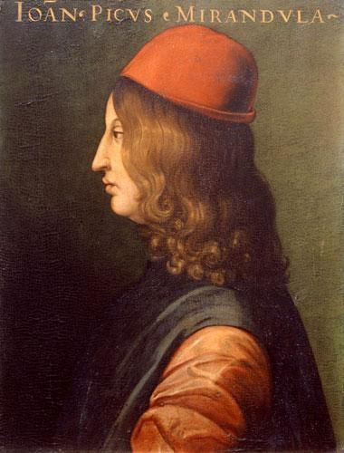
Revival in Neoplatonism
Marsilio Ficino attempted to reconcile Platonism with Christianity, according to the suggestions of early Church Fathers such as Saint Augustine.
In this spirit, Pico della Mirandola attempted to construct a syncretism of all religions.

Slide 11
Pico della Mirandola On the Dignity of Man
And still, as I reflected upon the basis assigned for these estimations, I was not fully persuaded by the diverse reasons advanced for the pre-eminence of human nature; that man is the intermediary between creatures, that he is the familiar of the gods above him as he is the lord of the beings beneath him; that, by the acuteness of his senses, the inquiry of his reason and the light of his intelligence, he is the interpreter of nature, set midway between the timeless unchanging and the flux of time; the living union (as the Persians say), the very marriage hymn of the world, and, by David's testimony but little lower than the angels.

Slide 12
Pico della Mirandola On the Dignity of Man
These reasons are all, without question, of great weight; nevertheless, they do not touch the principal reasons, those, that is to say, which justify man's unique right for such unbounded admiration. Why, I asked, should we not admire the angels themselves and the beatific choirs more? At long last, however, I feel that I have come to some understanding of why man is the most fortunate of living things and, consequently, deserving of all admiration; of what may be the condition in the hierarchy of beings assigned to him, which draws upon him the envy, not of the brutes alone, but of the astral beings and of the very intelligences which dwell beyond the confines of the world. A thing surpassing belief and smiting the soul with wonder. Still, how could it be otherwise? For it is on this ground that man is, with complete justice, considered and called a great miracle and a being worthy of all admiration.

